Slide 1

Goals, Principles, and Tools
17 February 2023

Slide 2

Goals

Slide 3
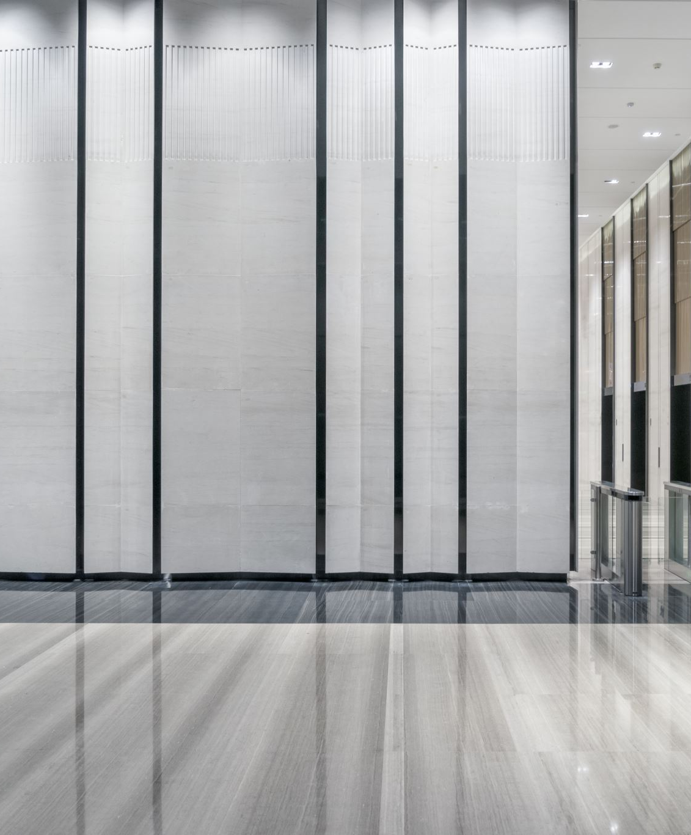
The Elevator Pitch
In 2-3 sentences, what does your project set out to do?
Focus on a general audience, such as a colleague outside your field.
“What” and “Why”

Slide 4
Goal Setting
Prevent scope creep
Necessary first step to creating a work plan, project schedule, and budget
Reduces communication failures and misunderstandings

Slide 5
Research Question/Research Problem
What is the central question your project seeks to answer, or the problem it sets out to solve?
What work is necessary to answer this question/address this problem?
Who benefits from this work?
What tools and expertise are needed to complete the work?
Technology
People
Training

Slide 6
Team Building
Identifying needs and finding people who can meet them
Developing workflows and team procedures
How do you communicate? How often do you meet? Who makes which decisions, and who else has input?
Internal team, collaborative planning
External advisors and funding bodies: responsibilities, suggestions?
Team size determines management needs, however
ALL teams need clear duties and expectations, regardless of size

Slide 7
Your Team
Who are your team members? (Think about all collaborators on the project, from students to technical assistants to trusted advisors)
How does each team member contribute to the project?
What expertise does each team member have? Does this expertise cover all the project’s needs?

Slide 8
Work Plan and Scheduling
What is the scope of the work?
Technical objectives
Research objectives
Who will perform the work?
Skills, time, funding
Credit
http://journalofdigitalhumanities.org/1-4/evaluating-collaborative-digital-scholarship-by-bethany-nowviskie/
https://hcommons.org/deposits/objects/hc:31188/datastreams/CONTENT/content
How long will the work take?

Slide 9
Project Charter
Describes project
Lists project goals
Outlines work plan for each term
Defines what is out of scope that term
Lists past/completed work
Defines roles and responsibilities, project milestones, and workflow processes
Describes constraints, assumptions, risks, and dependencies
Outlines project tools and infrastructure
Includes project budget
Describes sustainability plan
Includes annual reflections from each team member

Slide 10
Project Management
Managing expectations, time, budget, scope
Managing and streamlining workflow
Organizing and communicating with team members (establishing work culture—especially when team members aren’t used to collaborative work)
Tools: Governance documents (project charters, contracts, etc.) and annual planning cycles (tasks, outcomes, responsibilities, reporting)

Slide 11
Project Analysis and Evaluation
Clear goals make it easier to determine when they have been met and thus track progress.
One large project, or several small projects?

Slide 12
Example: Digital Restoration Drama
Initial research problem: Many plays written during the Restoration are difficult to access. They aren’t frequently reprinted, and the microfilm versions available through Early English Books Online are often difficult to read, impossible to search, and unusable to anyone with vision impairments.
Necessary work:
Determine scope of “Restoration”
catalogue plays (written? performed? published?)
determine metadata needs and how to store/represent them
locate copies (EEBO, EEBO-TCP, archival holdings)
determine priorities
figure out encoding needs, transcribe and encode each play
Figure out web hosting
Convert encoded texts to HTML
Integrate metadata with HTML
Part 1: Research Problem

Slide 13
Example: Digital Restoration Drama
Who benefits?: Me, anyone wanting to read/study/research/perform relatively obscure Restoration drama. Training tool for assistants wanting to learn TEI or DH.
Tools:
SQL database
Using open-source MySQL database software
PHP (to integrate SQL database with HTML)
XML-TEI
Often derived from 18thConnect’s TypeWright program
Need Oxygen XML Editor
Web hosting
Reclaim hosting
HTML + CSS
Hired external contractor, but needed to understand enough to make adjustments.
Part 2: Benefits and Tools

Slide 14
Example: Digital Restoration Drama
First Phase:
Learned many tools commonly used in DH projects.
TEI-encoded 8 plays
Learned some XSLT and Xquery
Built a MySQL database with metadata for ~500 plays.
Worked with an outside web developer and a student assistant
Presented at several conferences (both DH-focused and field-specific)
Had a formal DH component for my PhD dissertation
Current/Next Phase:
Joining Linked Early Modern Drama Online (LEMDO)
Converting TEI-encoded plays to LEMDO schema
Encoding more plays (high priority vs. low priority)
Working with/training additional transcribers
Adding critical material, refining and creating further documentation
Part 3: Project Status

Slide 15
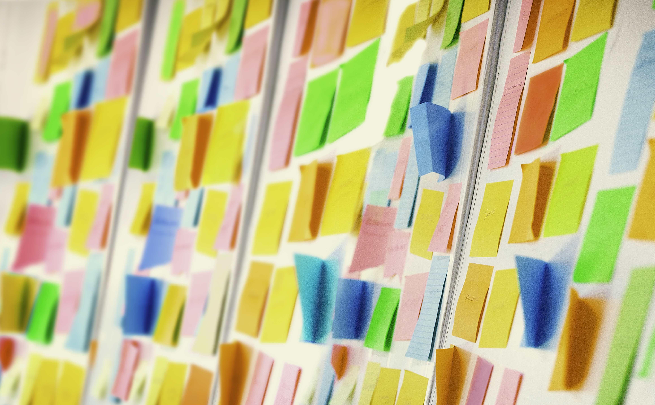
Principles

Slide 16
Externally Imposed Principles
Community driven
“Best practice”
Accepted standards across multiple projects, disciplines
Project longevity, interoperability
Examples: TEI, Dublin Core, Linked Open Data

Slide 17
Internal Principles
Specific to your project needs
Usually refinements of external principles/community standards
Consistency and control across all project materials
ODD and Schematron are important for this in XML documents
Examples: Using a subset of TEI, defining TEI attributes, controlled vocabularies, etc.

Slide 18
Documentation
What choices have you made?
How have you implemented them?
Should be comprehensive enough to allow someone to understand your project from the backend (i.e., without the user interface).
Like citing your sources or writing up your methodology, but for code.
Document as you go
Greater longevity, greater potential reach (more can be done with your data)

Slide 19

Break Time (10 minutes)
This Photo by Unknown Author is licensed under CC BY

Slide 20

Tools

Slide 21
Important Considerations
Support
Access
Usability
What support do you need from your institution? What are you willing to provide yourself?
How is this support managed?
What software/hardware is supported? Are there long term plans for support (or sunsetting/shifting support?)
What do you have to do to gain access to your project? Who controls the data?
Who all has access to the data/project? Who needs access to the data/project?
Are the tools open source/open access? If so, are they being maintained? If not, are you capable of maintaining them?
How easy is the tool to use? How quickly can new collaborators be trained?
How easy is the tool for users to navigate (not always applicable)?
If you are using custom/unusual tools, what kinds of documentation will be needed by both your team and your users?

Slide 22
Content Management Systems
Corpora (backend only, with API for frontend integration) – presentation from developer Dr. Bryan Tarpley.
Drupal/Islandora (backend only, with API for frontend integration)
Wordpress (backend and frontend; easy to start, lots of options for customization, integration of other systems; requires regular updates, some of which may break existing plugins)
Scalar (backend and frontend; fairly easy to use, more flexible than Omeka, but not as flexible as Wordpress, “born-digital publishing”)
Omeka (backend and frontend; very easy to use, but very limited in terms of customization)

Slide 23
Finding Hosting/Web Publishing
University hosting: likely requires working with university staff, may be subject to specific technologies or restrictions.
Reclaim Hosting/GoDaddy: Independent web hosting. Usually fairly cheap, but requires comprehensive understanding of how your site works (HTML, CSS, etc.)
GitHub Pages: Free, limited size and scope, requires knowledge of HTML

Slide 24
Data Standards, Programming Languages, and When You Might Use Them
XML/TEI – The standard for encoding texts in humanities contexts. Allows for a lot of customization, but within community standards.
XSLT—used to transform XML into other things
XQuery—used to query XML documents
HTML & CSS—Building and styling websites
JSON – Good for data storage, used by many common APIs (including Omeka)
CSV— “Comma Separated Values” (the underlying technology behind Excel spreadsheets)
RDF—a data model commonly used in linked open data projects
Python—good for data manipulation and natural language processing (among many, many other things!)
R—used for statistical computing, data analysis

Slide 25
Images and IIIF (Hosting)
University IIIF server
A CMS with IIIF built in (Islandora, Omeka, see full list on IIIF site)
Independent IIIF hosting (see IIIF site)

Slide 26
Images and IIIF (Viewing)
Universal viewer
Mirador/Mirador2
Others

Slide 27
Tools for Text Manipulation & Analysis
Out-of-the-box
Coding
Voyant Tools
HathiTrust Research Center Analytics
Google NGram Viewer
Catma
Open Refine
CollateX
AntConc
Python (Jupyter Notebooks, Google Colab, Pycharm)
R
XQuery

Slide 28
Databases
May be baked into your CMS
SQL
XML via eXide
MongoDB
Neo4j

Slide 29
Visualization
Gephi
Cytoscape (network analysis. Tutorial)
VisualEyes
TimelineJS

Slide 30
GIS/Mapping
ARC-GIS: Gold standard, but expensive and requires training.
QGIS: Free and open source GIS software.
CartoDB
Google Earth
(many of these use—or can use—KML, an XML-based format, for their data)

Slide 31
Annotation
Hypothes.is

